Slide 1
Using the Dispositions of RBPD Specialists to Guide Your Trauma-Informed Practice
Arielle Handevidt, MA, IMH-E
Notes:
1-1:10

Slide 2
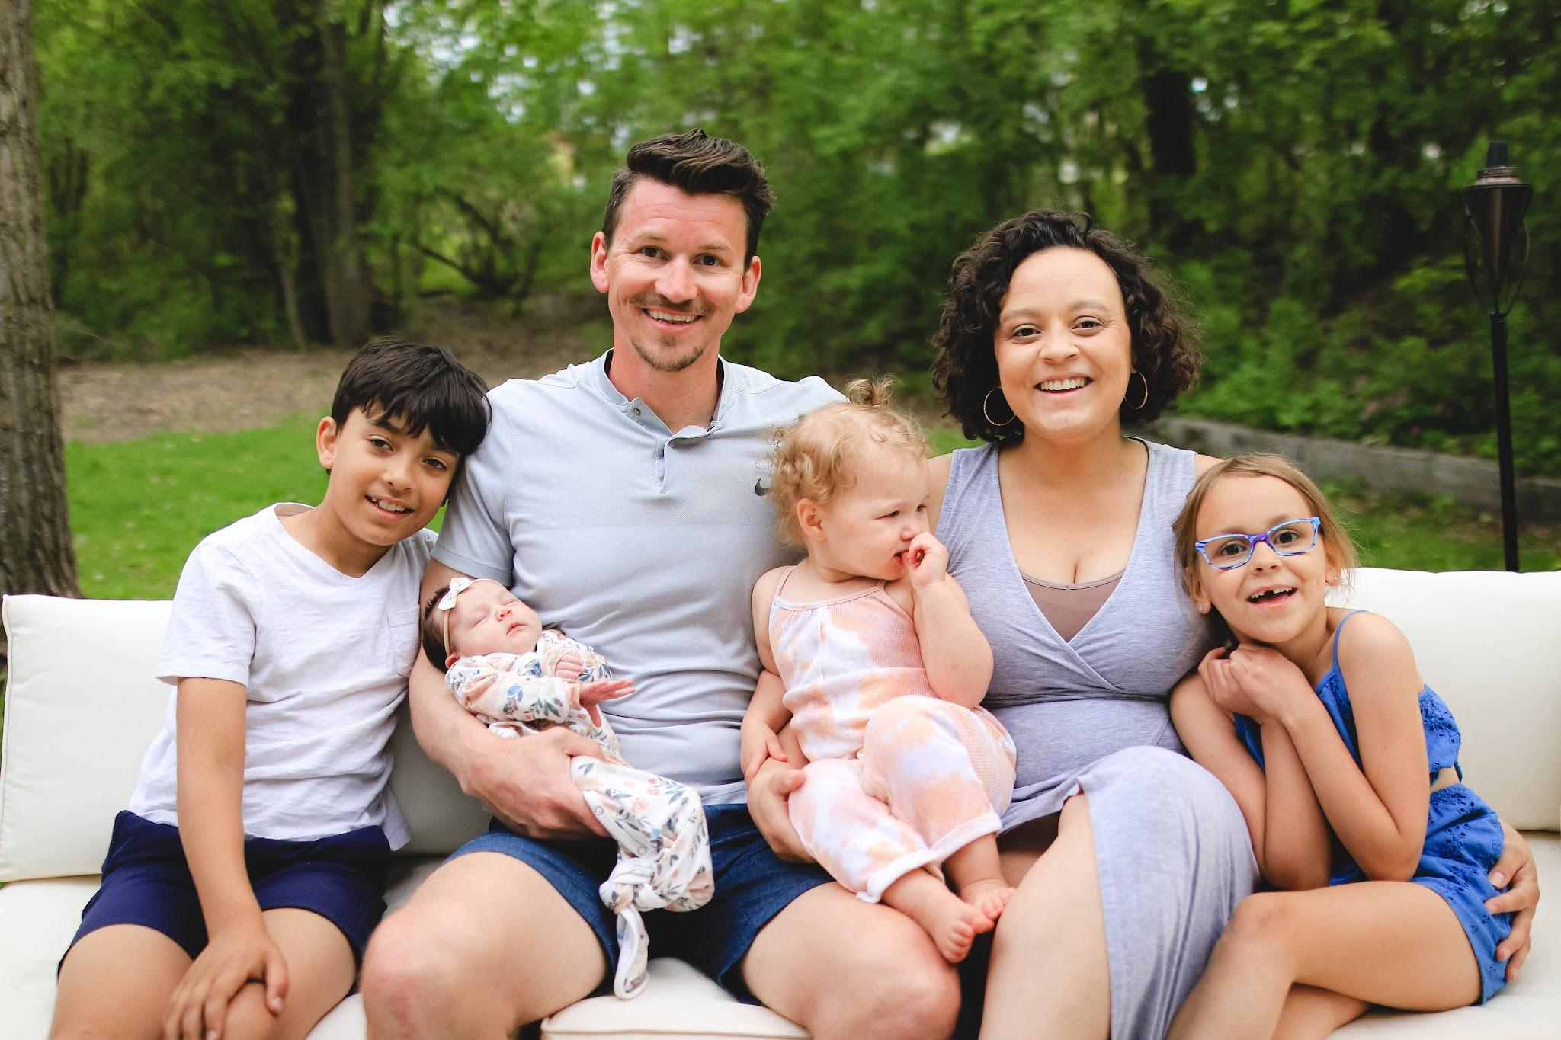
Arielle Handevidt
Director of Early Childhood at NAZ
Instructor, University of Minnesota
Biracial, black
Cis gendered female
Monolingual – English
Spouse, mother, daughter, friend
Notes:
This is the lens I will be speaking through today. All that I bring to this work is based in my own experiences and I acknowledge that everyone here brings their own experiences as well.

Slide 3
Infant and Early Childhood Mental Health
Is the developing capacity of the child from prenatal to six to:
• Form close and secure interpersonal relationships;
• Experience, regulate and express emotions;
• Explore the environment and learn…
All in the context of family, community and cultural expectations for young children.
Zero to Three, 2023
Notes:
Lens I bring

Slide 4
Objectives for the Day
Trauma KCFs | A. Understand trauma definitions, prevalence and relevant trauma concepts B. Understands that children’s stress response systems and behaviors are impacted by trauma C. Understands the intersection between trauma and development: trauma can derail development and the impact of trauma is influenced by the child’s developmental stage. G. Understands the impact of intergenerational, historical, and racial trauma on children, families, and caregivers.
Dispositions of RBPD | Purpose and vision, approach to others, view of self, mental approaches
Making connections | Intersection of trauma-informed/responsive care and RBPD dispositions

Slide 5
Group norms
What’s said here, stays here - what’s learned here, leaves here.
Be here with us-minimize distractions as much as possible.
Reflection and sharing will be part of today’s process as comfortable.
Today I encourage you to take notice of yourself ( thoughts, feelings, emotions etc..)
Be curious about any discomfort you may feel.
Take up space and share the air.
Take care of yourself as necessary.

Slide 6
Finding our space
Notes:
1:10-1:15
Grounding techniques help induce relaxation by focusing us on the present moment and all of the sensations associated with it.
Sensory check, a grounding technique:
As you sit or stand in this space, begin to take slow breaths in and out.
Notice what it feels like where you are standing/sitting (what does it feels like where your body connects with the ground).
Notice what you are seeing (what is in the room).
Notice what you are hearing (is there noise where you are, or nearby that you can hear, what does it sound like).
Notice anything you are smelling (are there scents in the room).
Notice any sensations in your mouth (dryness or hydration, certain tastes etc).
As you slowly breathe in and out, tune into each sensation.

Slide 7
01
Knowledge and Competency Framework
Content Area IX: Trauma Informed Care and Practice
Notes:
1:15-1:20

Slide 8
Stress and Trauma
Positive stress
Infant tummy time
Toddler doing a puzzle
Tolerable stress
New child care
Birth of a sibling
Minnesota Departments of Education, Human Services and Health. (2020)
Notes:
There is a stress to trauma continuum (Center on the Developing Child) which activates our body’s stress response system.
Positive stress promotes development by motivating us to master new skills. Children’s learning to cope with frustration and disappointment is an important life skill IF they are adequately supported by their caregivers in the process
Tolerable stress refers to events that can be overwhelming or even traumatic, but the child has the relational supports to cope with the situation.
Toxic stress/trauma can derail healthy development and is characterized by: Events that are perceived as threatening the life/physical integrity of the child or someone important to child (and what is perceived as a threat changes with children’s developmental stage); Causing an overwhelming sense of terror, helplessness, and horror; Producing intense physical effects such as a pounding heart, rapid breathing, trembling; And completely overwhelming the child’s available coping strategies.
The younger the child, the fewer coping strategies they have. Examples include: abuse, neglect, witnessing violence, separation from an important caregiver, painful medical procedures, accidents, deep poverty, refugee experiences and race-based trauma.

Slide 9
Stress and Trauma
Toxic stress/trauma
Abuse
Neglect
Witnessing violence
Separation from important caregiver
Poverty
Race-based trauma
Minnesota Departments of Education, Human Services and Health. (2020).
Notes:
Toxic stress/trauma can derail healthy development and is characterized by: Events that are perceived as threatening the life/physical integrity of the child or someone important to child (and what is perceived as a threat changes with children’s developmental stage); Causing an overwhelming sense of terror, helplessness, and horror; Producing intense physical effects such as a pounding heart, rapid breathing, trembling; And completely overwhelming the child’s available coping strategies.
The younger the child, the fewer coping strategies they have. Examples include: abuse, neglect, witnessing violence, separation from an important caregiver, painful medical procedures, accidents, deep poverty, refugee experiences and race-based trauma.

Slide 10
Defining trauma
Events that are perceived as threatening the life/phyiscal integrity of a child or someone important to a child
Causing an overwhelming sense of terror, helplessness, and horror
Producing intense physical effects
Completely overwhelming the child’s available coping strategies
Minnesota Departments of Education, Human Services and Health. (2020)

Slide 11
Toxic Stress
Too much
Too long
Too little support
Schreifels, T., & Langworthy, D. S. (2022)

Slide 12
Traumatic experiences are always stressful, but stressful situations are not always traumatic. However, chronic or toxic stress can be traumatic.

Slide 13
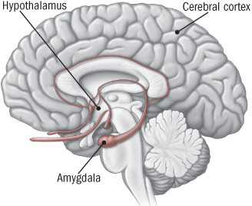
Brain Science
Eyes or ears (see or hear) danger
Sends signals to the Amygdala
Amygdala interprets the sounds or sights and perceives danger
Sends distress signals to the Hypothalamus
Hypothalamus is our command center
Communicates with the body’s nervous system
Harvard Health. (2020)
Notes:
1:20-1:30
AH
Amygdala - the brain’s “alarm system”
Our human biology wants us to survive and thrive.
Our brain response can be adaptive or maladaptive.

Slide 14
Stress response system
Fight
Flight
Freeze
Moving towards a perceived threat
Moving away from a perceived threat
Not moving when there is a perceived threat
Schreifels, T., & Langworthy, D. S. (2022)
Notes:
Fight, flight, or freeze is a good thing. It’s the brain’s way of protecting us from harm.
Over time, though, chronic trauma and stress can change how our brains respond to the world around us. We begin to react instinctively to protect ourselves, even if the threat is minor. It becomes easier to trigger our “fight, flight, or freeze” response.
Stress and trauma can change the way our brain responds to situations.

Slide 15
Development through our Enviornment
Our brain learns how to respond to our environment
We explore our environment based upon our senses
Biologically, we are designed to survive and thrive and experiences cause our brains to react
These reactions can be adaptive or maldaptive
Harden Bradford, D. J., & Jones Marlin, D. B. (2023).
Notes:
Calla story next slide

Slide 16
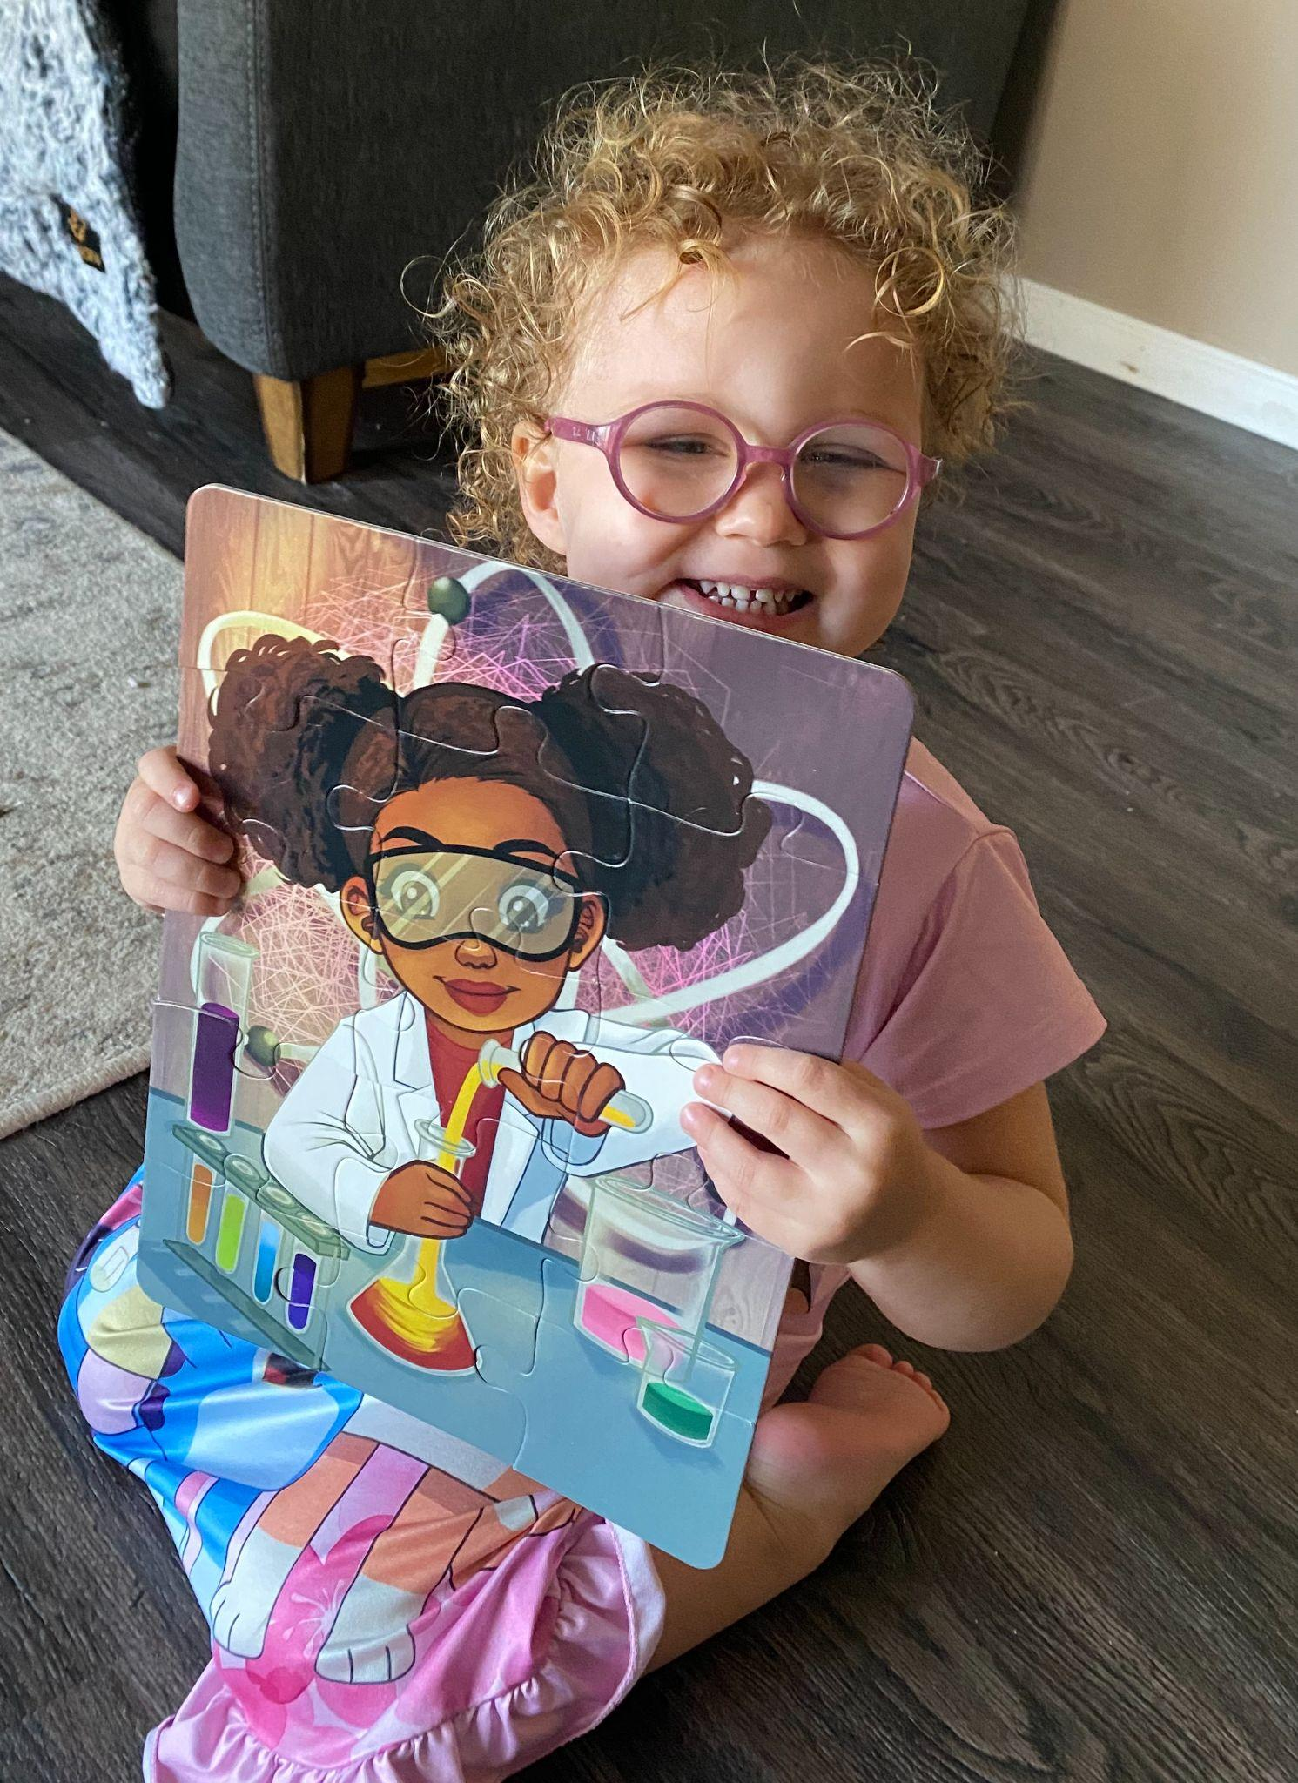
Notes:
Example: Calla and her glasses. Before she had glasses, she was very distant from people. Stayed close to a limited number of familiar caregivers. Was not friendly AT ALL to strangers. Didn’t talk a lot at school. She was adapting to what she could see in her environment. I would argue she didn’t feel safe (with low vision) so she adapted to protect herself. Once she got glasses, it shifted her personality.
Maladaptive: If Calla decided she was going to bite every child that came near her before she got glasses.

Slide 17
Environment through our senses
Paying attention to how we are reacting to our environments
Being sensitive to this process and honoring our needs
What does this look like for early educators?
What does this look like for young children?
Harden Bradford, D. J., & Jones Marlin, D. B. (2023).

Slide 18
Dr. Bianca Jones Marlin
“I am a human on this earth. Stressors are going to happen.”
Notes:
She goes on to talk about how she responds to that is important.
Modeling - what does it look like when we respond to stress? How can we model talking care of ourselves and having healthy emotional reponses to stress to support young children.

Slide 19
Resilience and Protective Factors
Resilience
Protective Factors
Comes from common and ordinary experiences
Safe, stable relationships
Social supports
Parental resilience
Basic needs met
Underwood, M. K., & Rosen, L. H. (2013).
Notes:
1:30-1:40
Defined as “good outcomes in spite of serious threats to adaptation or development”

Slide 20
Classroom protective factors
Where do we see protective factors showing up in the early childhood classroom?
Discussion
Notes:
Group share: where do we see protective factors showing up in the early childhood classroom?

Slide 21
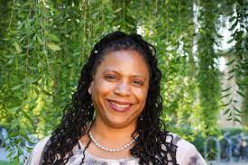
Family culture is present in all caregiving interactions. It is within culturally informed relationships that all development unfolds. Children learn to experience, regulate, and express emotion as defined by their cultural communities. Children form protective relationships with caregivers that can ensure their safety within inequitable and racist environments. Children bring their cultural self to learning environments using exploration, yet some are encouraged while others are punished.
Dr. Barbara Stroud, 2021

Slide 22
Historical and Racial Trauma
Handout: Diversity Informed Tenets
Notes:
1:40-1:50
10 minutes

Slide 23
Pair and Share
Notes:
1:50-2:00
Where you have come from influences how you react to something - reactions to video
5 minutes pair and share
5 minutes large group share

Slide 24
Energy Release
Notes:
2:00-2:05
5-4-3-2-1 shake (hand, foot)

Slide 25
Dispositions of an RBPD Specialist
Notes:
2:05-2:30

Slide 26
Dispositions
“The tendency or inclination to believe or act in certain ways.” [Dottin, 2010; Teven, 2007]
“Dispositions comprise habits of mind rather than mindless habits.” [Ross-Voseles & Moss, 2007]
“Dispositions influence how people interact with others.”
“Dispositions impact how and what RBPD specialists notice, how they approach others, and how they see challenges.”
The Center for Early Education and Development, University of Minnesota, for the Minnesota Department of Human Services . (n.d.).
Notes:
“similar to professional beliefs or values systems, but they are more than that. Dispositions extend to professional modes of conduct and the ways in which beliefs and attitudes are displayed by teachers’ actions in and out of the classroom.”

Slide 27
Dispositions
“Dispositions as habits of mind can be seen in one’s view of self and others, sense of purpose, empathy, openness to perspectives, inclination toward reflection and critical thinking.”
The Center for Early Education and Development, University of Minnesota, for the Minnesota Department of Human Services . (n.d.).
Notes:
“similar to professional beliefs or values systems, but they are more than that. Dispositions extend to professional modes of conduct and the ways in which beliefs and attitudes are displayed by teachers’ actions in and out of the classroom.”

Slide 28
Meaningful Purpose and Vision
Sense of integrity
Discrete
Objective
Commitment to learning and growing
Values data
Effective
Notes:
• Sense of integrity: Responsible and reliable, honest, keeps promises, follows through
• Discrete: Complies with federal, state, and program policies relating to confidentiality
• Objective: fosters and enhances the teaching and learning process while exercising judgment about personal and professional boundaries; displays genuineness
• Commitment to learning and growing (self and others)
• Values data: (Observations, stories and experiences, formal assessment) as a pathway to understanding, applying and supporting effective practice
• Effective: Nurtures high expectations; demonstrates self-direction and confidence; encourages others to display their own skills and strengths.

Slide 29
Approach to Others
Empathetic
Positive view of others
Values and appreciates differences
Culturally humble
Compassionate and emotionally available
Able to use humor
Notes:
Approach to others: (Individual; focus on adult learners; social-emotional and communication), including:
• Empathetic
• Positive view of others (enjoys working with others; optimistic; believes in ability to learn; fosters self-efficacy)
• Values and appreciates differences; non-judgmental
• Culturally humble: Appreciates and capitalizes on diversity; elicits other perspectives; aware of and acts to reduce own biases
• Compassionate and emotionally available
• Able to use humor

Slide 30
Approach to Others
Reflective
Respectful
Collaborative
Vocal
Holds self and others accountable
Notes:
Approach to others: (Individual; focus on adult learners; social-emotional and communication), including:
• Reflective, listening demeanor, being present
• Respectful: Showing regard for the needs and experiences of others
• Collaborative: Views self as teaching and learning, in partnership
• Vocal: Willing to openly engage and respond to peers, clients, administrators and community
• Comfortable and willing to hold self and others accountable for change.

Slide 31
View of Self
Reflects
Resilient
Confident
Humble
Notes:
View of self
• Reflects: On own practice, own growth and accountability
• Resilient: Inventive, resourceful, flexible
• Confident: Positive view of self as able to make a difference, grow and learn
• Humble: Places the needs of learner and/or learning task above own ego

Slide 32
Mental Approaches
Observant
Reflective
Persistent
Curious/inquisitive
Notes:
Mental approaches towards ideas, tasks, or issues—the ability to examine closely, to critique, and to ask questions. RBPD specialists do not accept the status quo at face value but employ higher level thinking skills to evaluate, analyze, and synthesize. Self-evaluation and reflection characterize individuals with this set of dispositions, including:
• Observant: Models taking in information with one’s own senses (watching and listening) with purpose; works to be objective in noticing what people say or do, as well as pertinent surroundings and context; intentionally gathers and records observations; links observation to a sense of curiosity and ability to see from other perspectives • Reflective: Consistently takes time to evaluate effectiveness of consultation and behavior in terms of the larger goals of consultation; nurtures reflectivity in clients; reflects on own growth and accountability • Persistent: Exhibits a willingness to pursue solutions to problems or questions; gathers relevant data and persistently seeks to improve situations or areas of need; risk-taker • Curious/inquisitive: Willingness to wonder, question, explore options, analyze and look at different sides of an issue; recognizes the possibility of error in one’s own beliefs and practices.

Slide 33
Small group Activity
Notes:
2:15-2:30
Chart paper around the room
Each group takes a category: Meaningful purpose and vision, approach to others, view of self, mental approaches
Use post-its to begin to name what this looks like in RBPD work in real time

Slide 34
Break
15 minutes
Notes:
2:30-2:45
Where you have come from influences how you react to something - reactions to video
5 minutes pair and share
5 minutes large group share

Slide 35
Reflection
What disposition comes naturally to you?
What disposition is challenging for you?
What disposition do you hope to focus on in your upcoming week? Month? Year?
Notes:
2:45-2:55

Slide 36
Guiding principles of trauma responsive care
Notes:
2:55-3:05

Slide 37
Safety
Ensuring the physical, social and emotional safety of children is vital, as is adequately supporting the staff who care for them.
“In this moment, I am safe”
“In this moment, I am loved”
“In this moment,.......”
Guiding principles. Child Trauma and Wellbeing. (n.d.).
Notes:
Children who have experienced trauma have had their sense of safety disrupted
Providing nurturing environments - avoiding triggers
Supporting strong caregiver-child connections
Importance of predictability, routines, consistency
Empowering children to be their authentic selves and allowing children to express their ideas, thoughts, beliefs, needs, identities, self-concepts and emotions without fear of ridicule, shame or dismissal.
Validating feelings
Culturally affirming approaches
Modeling and encouraging children
Staff need to feel safe

Slide 38
Transparency and trust
Promoting transparency and building trust between children and caregivers creates an important foundation for healthy relationships.
Actively engaging in repair when their is rupture in relationships
“What are ways in which you have celebrated and acknowledged different cultural backgrounds in your classroom?”
Guiding principles. Child Trauma and Wellbeing. (n.d.).
Notes:
Transparent conversations - clear, open
Being honest and realistic
Admitting when we have made mistakes
Respectful environments
Hiring staff that represent the community served
Building on family strengths
Being consistent
Discovering families strengths and connections

Slide 39
Empowerment, Voice, and Choice
Listening to and engaging with children – and their caregivers – helps empower them, while nurturing their strengths, capabilities and talents.
Empowering caregivers to make decisions about their own lives.
“When is a time you overcame a challenge?”
Reflecting on the difference between decisions that are actively harmful and those that are different decisions than we would personally make.
Guiding principles. Child Trauma and Wellbeing. (n.d.).
Notes:
Children who have experienced trauma may feel like they do not have control of their situations. This can cause distruptions to development.
Strengths-based, resiliency-focused (Glows and grows)
Provide choice for children and caregivers
Family’s culture seen as a source of strength

Slide 40
EQUITY, ANTI-BIAS EFFORTS, AND CULTURAL AFFIRMATION
Addressing discrimination, promoting equity, and practicing cultural affirmations can help avoid re-traumatizing children and their families.
Diversity Informed Tenets for Work with Infants, Children, and Families
Guiding principles. Child Trauma and Wellbeing. (n.d.).
Notes:
Acknowledging our own implicit bias
Being aware of how these biases and positions of power/privilege may influence interactions with children and families.
Open and honest dialogues
Partnering and collaborating with community orgs
Policies and principles that actively fight against racism

Slide 41
Healthy Relationships and Interactions
Teaching and modeling healthy relationship behaviors help children learn to cultivate positive interactions with peers and family members.
Short Term Interactions
Long Term Interactions
Guiding principles. Child Trauma and Wellbeing. (n.d.).
Notes:
Short-term interactions can have a long lasting impact on children.
Respect: Introduce yourself, explain your role, share which pronouns you use, and provide clear information about what to expect regarding any process they are going through.
Effective Communication: Practice active listening, ask questions in a curious, non-judgmental manner, provide information in a developmentally appropriate manner in the child’s preferred language, and be mindful of your tone, body language, and nonverbal cues.
Validation & Compassion: Recognize that children’s feelings are valid, demonstrate compassion and patience, and provide positive reinforcement of behaviors that demonstrate resiliency.
Control & Choice: Consistently signal opportunities for children and families to have control and choices in the matters that pertain to them. For instance, offer children opportunities to pause or stop the process so they can have a sense of control and agency.
Long term interactions:
Paying close attention to what children and families say and asking intentional questions to get to know them and understand their perspectives better.
Talking with children and families about trauma and potential reactions to it.
Explaining to children and families that their thoughts, feelings, and behaviors are normal responses to traumatic situations. They may have been helpful or critical to surviving difficult circumstances.
Teaching and modeling healthy ways of recognizing and expressing feelings and coping with stressful situations, which may include addressing family and cultural norms.
Coaching children and families on strategies for effective communication, boundary setting, and other interpersonal skills used across different cultural contexts. Also, role-modeling these strategies and seeking to understand existing communication strategies and skills.
Use the Four Building Blocks of HOPE to identify and support existing strengths of the family
Educating families about how to interact with children in trauma-informed and responsive ways.
Seeking additional formal and informal resources and facilitating connections when appropriate.

Slide 42
Small Group Work
How do the RBPD Dispositions show up in each of the five guiding principles for trauma responsive work?
What does it look like when you are in the classroom?
What does it look like in a group training/setting?
What does it look like working one on one with a teacher/director?
What does it look like with your peers?
Notes:
3:05-3:30

Slide 43
Shared Learnings
Notes:
3:30-3:45

Slide 44
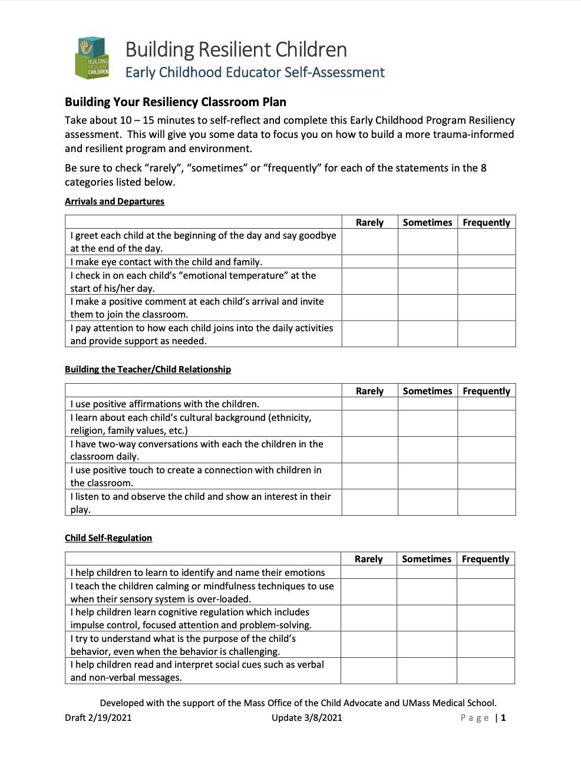
https://childwellbeingandtrauma.org/toolkits/brc-toolkit/
Notes:
3:45-3:50

Slide 45
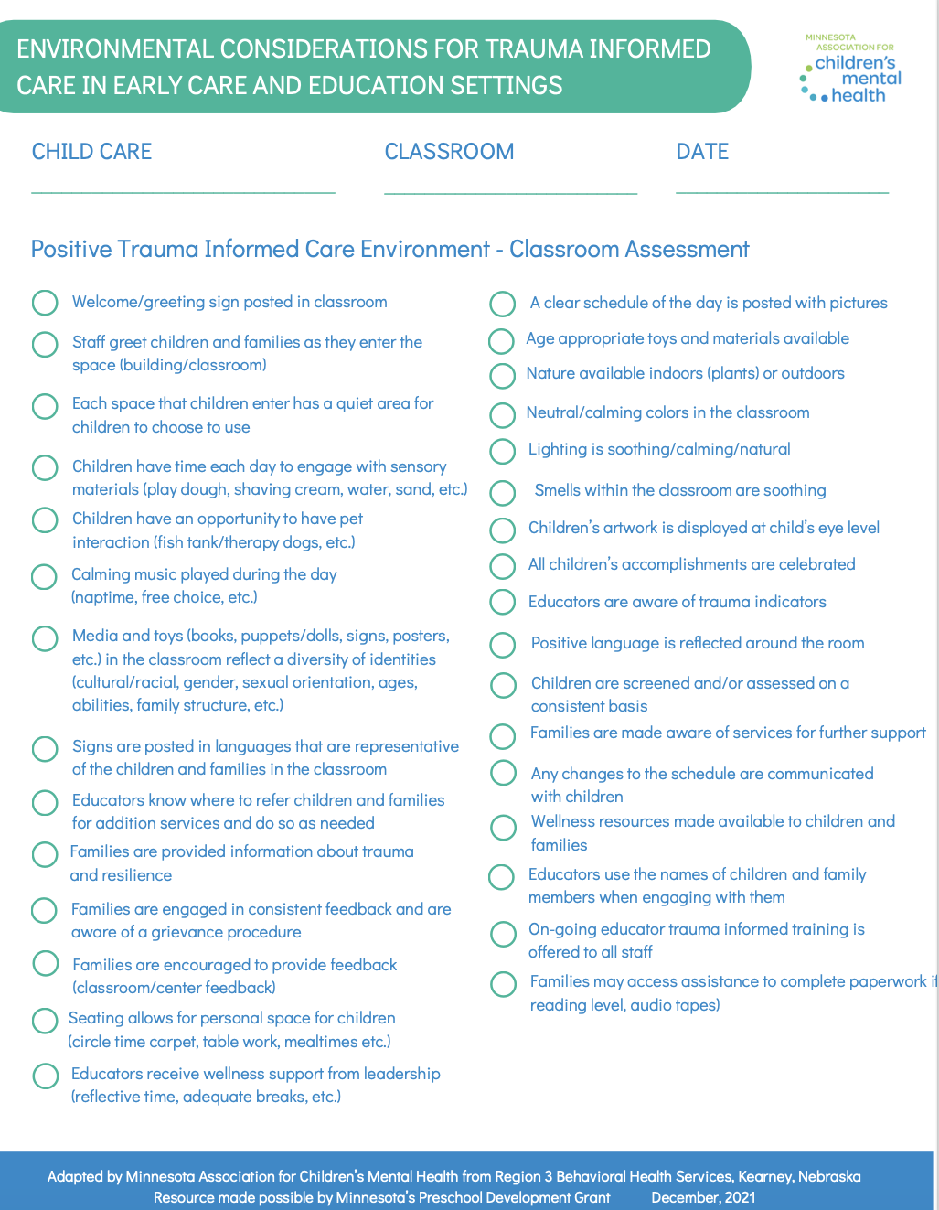
https://macmh.org/publications/resources-for-healing-centered-practice/

Slide 46
Jeree Pawl
“How you are is as important as what you do.”

Slide 47
Action Steps
I am sharing with others…..
I am being curious about….
I am implementing….
Notes:
3:50-3:55

Slide 48
Three Deep Breaths
Notes:
3:55-4:00

Slide 49
References
Harden Bradford, D. J., & Jones Marlin, D. B. (2023, April 19). Session 303: How Trauma Affects the Brain. Therapy for Black Girls. other, iHeartPodcasts.
Minnesota Departments of Education, Human Services and Health. (2020). Minnesota’s Knowledge and Competency Framework for Early Childhood Professionals: Infants and Toddlers, 66–74.
Understanding the stress response. Harvard Health. (2020, July 6). Retrieved from https://www.health.harvard.edu/staying-healthy/understanding-the-stress-response
The Center for Early Education and Development, University of Minnesota, for the Minnesota Department of Human Services . (n.d.). Minnesota’s Knowledge and Competency Framework for Relationship-based Professional Development Specialists, 8–9.
Underwood, M. K., & Rosen, L. H. (2013). Social Development: Relationships in infancy, childhood, and adolescence. Guilford Press.
Schreifels, T., & Langworthy, D. S. (2022). When Children Experience Trauma. Retrieved from https://macmh.org/publications/resources-for-healing-centered-practice/.
Infant and early childhood mental health. ZERO TO THREE. (2022, November 9). Retrieved from https://www.zerotothree.org/issue-areas/infant-and-early-childhood-mental-health/
Guiding principles. Child Trauma and Wellbeing. (n.d.). Retrieved from https://childwellbeingandtrauma.org/becoming-trauma-informed-and-responsive/guiding-principles/

Slide 50
Thank you!
Ahandevidt@the-naz.org

